Slide 1
BIBS
MRM Deep Learning 분석
최정인

Slide 2
INDEX
01 Summary of Oncotarget paper
02 Marker Selection using DNN
03 Results compared to Oncotarget Paper

Slide 3
01
Summary of Oncotarget paper

Slide 4
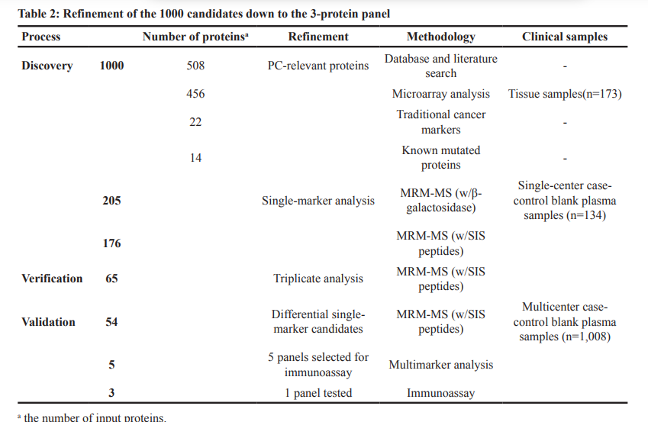
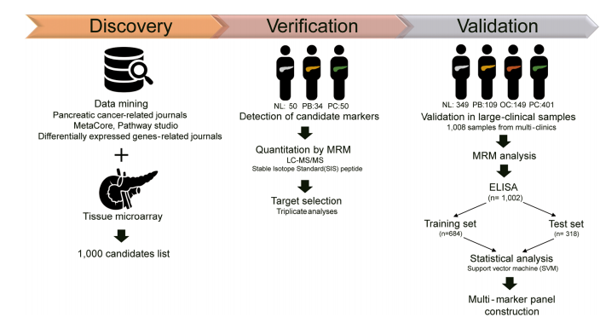
MRM DL 분석
01. Summary of Oncotarget Paper
Notes:
심리학에서 나온 자극-반응의 이론을 토대로,

Slide 5
MRM DL 분석
01. Summary of Oncotarget Paper
Gene Name | Peptide Sequence
CLU | ASSIIDELFQDR
 | TLLSNLEEAK
C5 | NADYSYSVWK
 | GGSASTWLTAFALR
LRG1 | DLLLPQPDLR
 | VAAGAFQGLR
ITIH4 | AGFSWIEVTFK
 | LALDNGGLAR
BTD | ILSGDPYCEK
 | LSSGLVTAALYGR
PPBP | NIQSLEVIGK
 | ICLDPDAPR
SERPINC1 | IEDGFSLK
 | VAEGTQVLELPFK
LDHB | GLTSVINQK
 | IVVVTAGVR
CFH | GEWVALNPLR
 | TGESVEFVCK
C4BPA | LSLEIEQLELQR
 | TWYPEVPK
APOC1 | EFGNTLEDK
 | EWFSETFQK
THBS1 | GFLLLASLR
 | TIVTTLQDSIR
IGFBP3 | ALAQCAPPPAVCAELVR
 | YGQPLPGYTTK
Gene Name | Peptide Sequence
TTR | AADDTWEPFASGK
KLKB1 | DSVTGTLPK
IGFBP2 | LIQGAPTIR
PROS1 | NNLELSTPLK
CFI | VFSLQWGEVK
C1R | DYFIATCK
C4BPB | ALLAFQESK
SOD3 | VTGVVLFR
MBL2 | FQASVATPR
ITIH2 | IQPSGGTNINEALLR
HRG | DGYLFQLLR
CTSD | VSTLPAITLK
C7 | VLFYVDSEK
C6 | TLNICEVGTIR
APOH | VCPFAGILENGAVR
Gene Name | Peptide Sequence
AGT | DPTFIPAPIQAK
IFRD1 | GLIDLTLDK
ADIPOQ | GDIGETGVPGAEGPR
ECM1 | ELLALIQLER
C1S | TNFDNDIALVR
GSTP1 | ASCLYGQLPK
CORO1C | CDLISIPK
VIM | ILLAELEQLK
PTPRJ | DTEVLLVGLEPGTR
PKM2 | CDENILWLDYK
FCGBP | FAVLQENVAWGNGR
CPN2 | LSNNALSGLPQGVFGK
COL4A2 | GLPGEVLGAQPGPR
SERPINA5 | GFQQLLQELNQPR
ICAM1 | LLGIETPLPK
CA19-9
SEPP1(SELENOP) | CINQLLCK
68 Peptide
54 Protein
14 Protein of 28 Multiple Peptide
(2 Peptide per each protein)
Notes:
심리학에서 나온 자극-반응의 이론을 토대로,

Slide 6
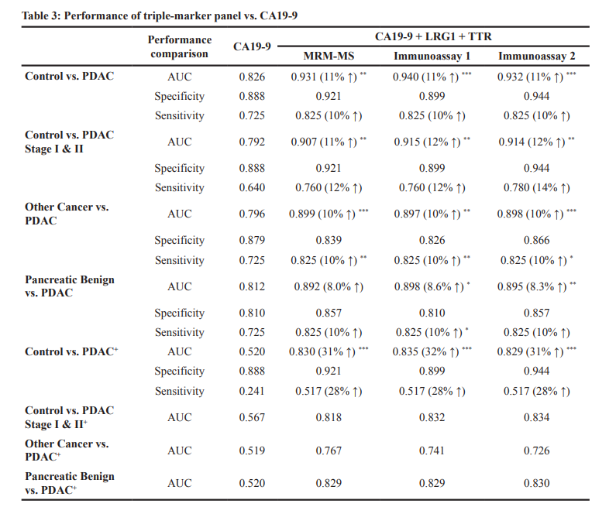
MRM DL 분석
01. Summary of Oncotarget Paper
Notes:
심리학에서 나온 자극-반응의 이론을 토대로,

Slide 7
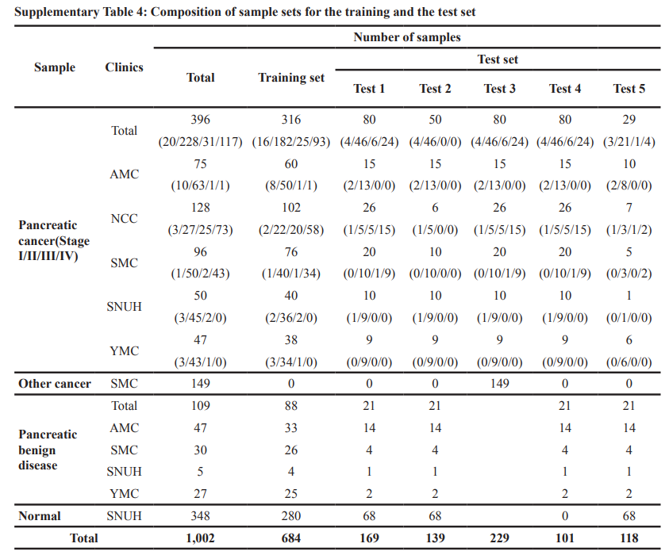
MRM DL 분석
01. Summary of Oncotarget Paper
Notes:
심리학에서 나온 자극-반응의 이론을 토대로,

Slide 8
02
Marker Selection Using DNN

Slide 9
MRM DL 분석
02. Marker Selection Using DNN
Peptide (40)
AADDTWEPFASGK
DSVTGTLPK
LIQGAPTIR
NNLELSTPLK
VFSLQWGEVK
DYFIATCK
ALLAFQESK
VTGVVLFR
FQASVATPR
IQPSGGTNINEALLR
DGYLFQLLR
VSTLPAITLK
VLFYVDSEK
TLNICEVGTIR
VCPFAGILENGAVR
DPTFIPAPIQAK
GLIDLTLDK
GDIGETGVPGAEGPR
ELLALIQLER
TNFDNDIALVR
ASCLYGQLPK
CDLISIPK
ILLAELEQLK
DTEVLLVGLEPGTR
CDENILWLDYK
FAVLQENVAWGNGR
LSNNALSGLPQGVFGK
GLPGEVLGAQPGPR
GFQQLLQELNQPR
CINQLLCK
LLGIETPLPK
Protein (40)
TTR
KLKB1
IGFBP2
PROS1
CFI
C1R
C4BPB
SOD3
MBL2
ITIH2
HRG
CTSD
C7
C6
APOH
AGT
IFRD1
ADIPOQ
ECM1
C1S
GSTP1
CORO1C
VIM
PTPRJ
PKM2
FCGBP
CPN2
COL4A2
SERPINA5
SEPP1(SELENOP)
ICAM1
Peptide (28)
ASSIIDELFQDR
TLLSNLEEAK
NADYSYSVWK
GGSASTWLTAFALR
DLLLPQPDLR
VAAGAFQGLR
AGFSWIEVTFK
LALDNGGLAR
ILSGDPYCEK
LSSGLVTAALYGR
NIQSLEVIGK
ICLDPDAPR
IEDGFSLK
VAEGTQVLELPFK
GLTSVINQK
IVVVTAGVR
GEWVALNPLR
TGESVEFVCK
LSLEIEQLELQR
TWYPEVPK
EFGNTLEDK
EWFSETFQK
GFLLLASLR
TIVTTLQDSIR
ALAQCAPPPAVCAELVR
YGQPLPGYTTK
Protein (14)
CLU
C5
LRG1
ITIH4
BTD
PPBP
SERPINC1
LDHB
CFH
C4BPA
APOC1
THBS1
IGFBP3
Notes:
심리학에서 나온 자극-반응의 이론을 토대로,

Slide 10
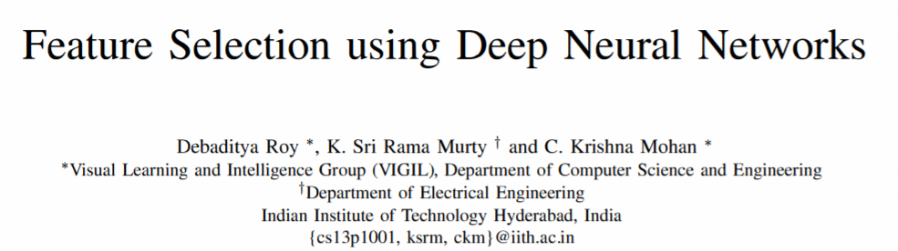
MRM DL 분석
02. Marker Selection Using DNN
Notes:
심리학에서 나온 자극-반응의 이론을 토대로,

Slide 11





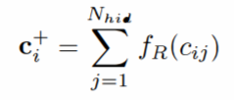
MRM DL 분석
02. Marker Selection Using DNN
ith dimension of the input connected to jth hidden neuron
it can be concluded that the features with highest c+ are more likely to instigate the neurons to participate in classification.
Notes:
심리학에서 나온 자극-반응의 이론을 토대로,

Slide 12
MRM DL 분석
02. Marker Selection Using DNN
최종적으로 학습된 모델에서,
각 input에 연결된 다음 hidden node들의 a 값이 클수록 중요한 feature
ith dimension of the input connected to jth hidden neuron
it can be concluded that the features with highest c+ are more likely to instigate the neurons to participate in classification.
Notes:
심리학에서 나온 자극-반응의 이론을 토대로,

Slide 13
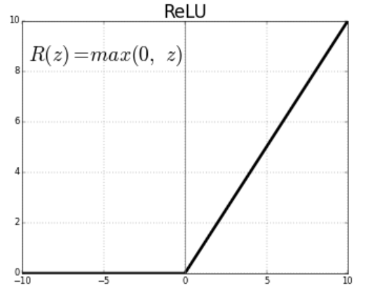

MRM DL 분석
02. Marker Selection Using DNN
Feature Selection Using DNN
Group
(Pos/Neg)
Peptide
Protein
Hidden Layer
nn.Linear
+ ReLu
nn.Linear
+ ReLu
Sigmoid
각 Peptide에 연결된 Protein에 해당하는
가중치(ReLu값)이 클수록 더 중요한 Peptide
각 Protein에 연결된 hidden node에 해당하는
가중치(ReLu값)이 클수록 더 중요한 Protein
Notes:
심리학에서 나온 자극-반응의 이론을 토대로,

Slide 14
03
Results compared to Oncotarget

Slide 15
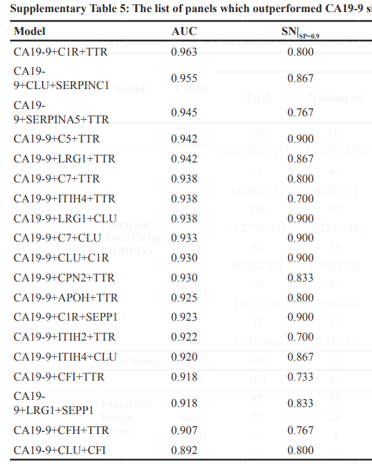
MRM DL 분석
03. Results Compared to Oncotarget
Gene Name | Peptide Sequence
TTR | AADDTWEPFASGK
CLU | ASSIIDELFQDR
 | TLLSNLEEAK
LRG1 | DLLLPQPDLR
 | VAAGAFQGLR
C1R | DYFIATCK
C7
 | LSSGLVTAALYGR
C5 | NADYSYSVWK
 | GGSASTWLTAFALR
CFI | IEDGFSLK
CFH | GEWVALNPLR
 | TGESVEFVCK
SERPINC1 | GEWVALNPLR
 | TGESVEFVCK
ITIH4 | AGFSWIEVTFK
 | LALDNGGLAR
The final 5 panels in Oncotarget
CA19-9+CLU+SERPINC1
CA19-9+C5+TTR
CA19-9+LRG1+TTR
CA19-9+ITIH4+CLU
CA19-9+LRG1+CLU
Top 10 Gene Selected
Top 17 Peptide Selected
CA19-9
Notes:
심리학에서 나온 자극-반응의 이론을 토대로,

Slide 16
MRM DL 분석
03. Results Compared to Oncotarget
Results Compared to Oncotarget
 | Performance | CA19-9 | CA19-9+LRG1+TTR | CA19-9+CLU+TTR
Control vs PDAC | AUC | 0.826 | 0.931 | 0.940
 | Specificity | 0.888 | 0.921 | 0.931
 | Sensitivity | 0.725 | 0.825 | 0.830
Other Cancer vs PDAC | AUC | 0.792 | 0.907 | 0.910
 | Specificity | 0.888 | 0.921 | 0.911
 | Sensitivity | 0.640 | 0.760 | 0.800
Pancreatic Benign vs PDAC | AUC | 0.796 | 0.899 | 0.900
 | Specificity | 0.879 | 0.839 | 0.820
 | Sensitivity | 0.725 | 0.825 | 0.781
Control vs PDAC* | AUC | 0.812 | 0.892 | 0.892
 | Specificity | 0.810 | 0.857 | 0.791
 | Sensitivity | 0.725 | 0.825 | 0.831
Other Cancer vs PDAC* | AUC | 0.520 | 0.830 | 0.852
 | Specificity | 0.888 | 0.921 | 0.721
 | Sensitivity | 0.241 | 0.517 | 0.681
Pancreatic Benign vs PDAC* | AUC | 0.520 | 0.829 | 0.892
 | Specificity
 | Sensitivity
Notes:
심리학에서 나온 자극-반응의 이론을 토대로,

